Slide 1
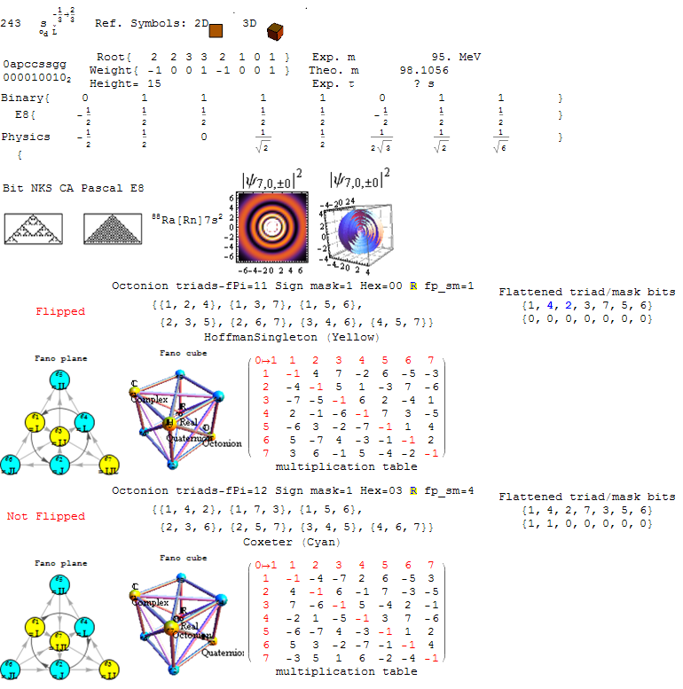
E8 Integrated with Binary, Octonions, Particles, Wolfram’s New Kind of Science (NKS), and the Periodic Table of Elements

Slide 2
E8 Number Indexed by Clifford/Pascal Order
E8 Number Indexed by Clifford/Pascal Order

Slide 3
Particle Physics Identifiers
Particle Physics Identifiers

Slide 4
Bitwise Quantum Particle Structure
Bitwise Quantum Particle Structure

Slide 5
E8 Algebra Root/Weight/Height
E8 Algebra
Root/Weight/Height

Slide 6
Binary/E8/Physics 8 Dimensional Vertex Location
Binary/E8/Physics
8 Dimensional Vertex Location

Slide 7
Wolfram’s NKS Cellular Automata (CA)
Wolfram’s NKS Cellular Automata (CA)

Slide 8
Periodic Table Element & Structure
Periodic Table Element & Structure

Slide 9
Octonion Fano Plane, Cubic, & Multiplication Table
Octonion Fano Plane, Cubic, & Multiplication Table

Slide 10
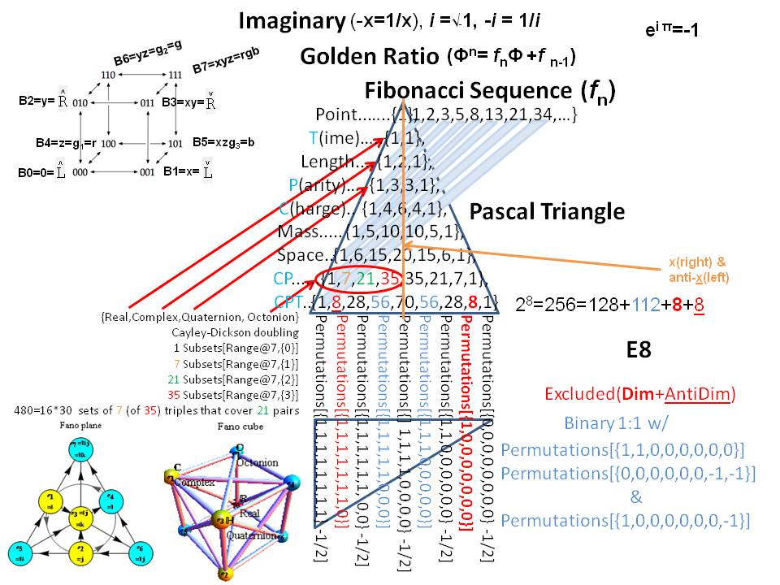
E8, Binary and the Pascal Triangle

Slide 11
E8 and the Lisi extended Standard Model (eSM) Particle Assignments

Slide 12
Bitwise Quantum Particle Assignments

Slide 13
E8 Algebra Roots (+/- 120)

Slide 14
E8 Roots to Chemical Elements (- are “Anti-Elements”)

Slide 15
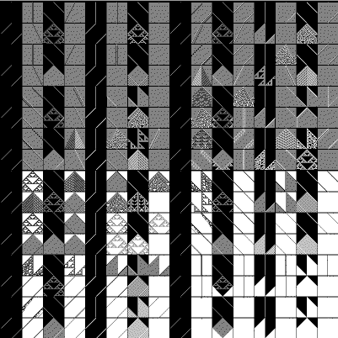
Assignment of 256 to NKS CA

Slide 16
Quantum Particle Symmetries of Octonions

Slide 17
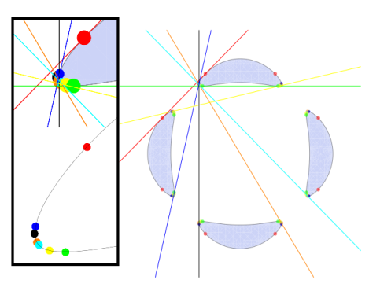
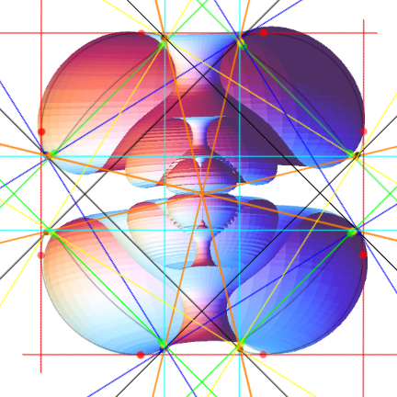
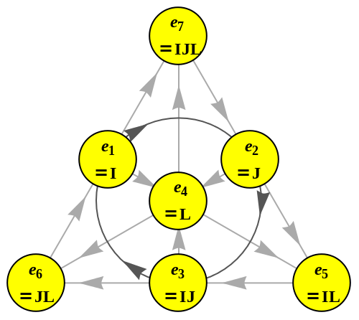
28 Octonion Fano Plane Triangles 28 Trott Quartic and Dual Curve Bitangents Electron Orbital Probability Density Legendre Functions

Slide 18
Quantum Particle Symmetries (pType and Gen)

Slide 19
Quantum Particle Symmetries (Anti)

Slide 20
Quantum Particle Symmetires (Color)

Slide 21
Quantum Particle Symmetries (Spin)

Slide 22
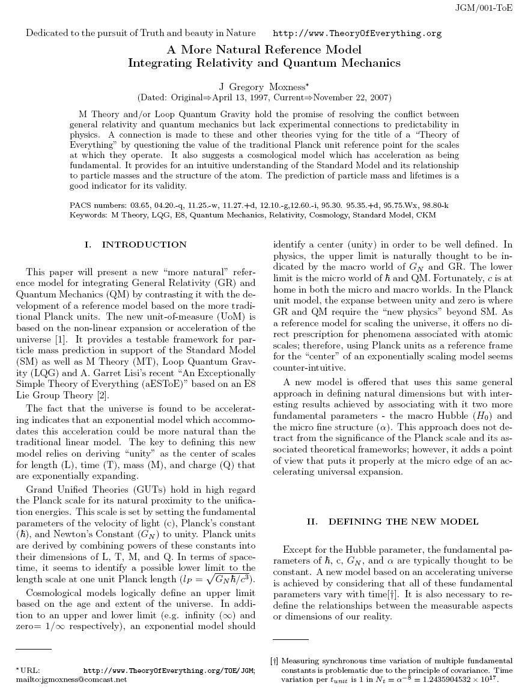
MyToE model Theoretical and Experimental Mass/ Lifetime

Slide 23
Binary, E8 and Physics Coordinates

Slide 24
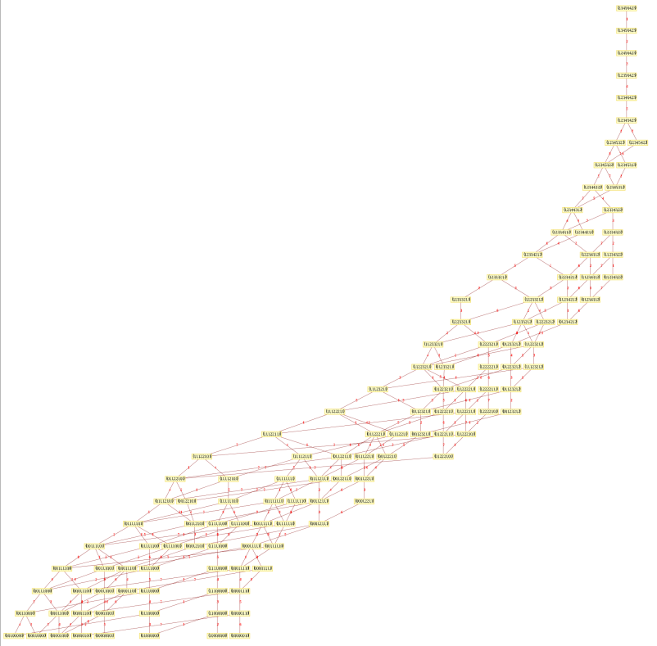
E8 Lie Algebra Root/Weight/Height and the Hasse Diagram

Slide 25
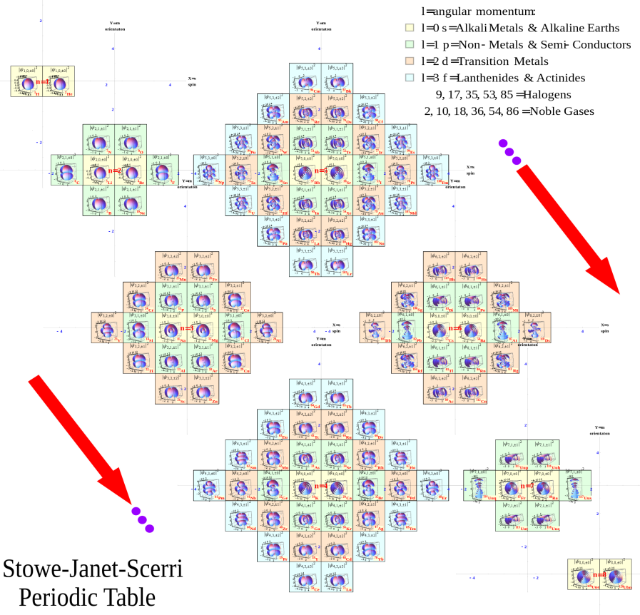
Chemical Element Quantum Numbers and the Stowe-Janet-Scerri Periodic Table with 3D Spherical Harmonic Electron Density Probability Contours

Slide 26
Octonion Triads and the Fano Plane

Slide 27
Fano Plane and Fano Cubic

Slide 28
Fano Plane and Multiplication Table

Slide 29
Assigning flattened triads to the Fano Plane Mnemonic
6
2
1
4
7
3
5

Slide 30
Flattened Triad Procedure

Slide 31
“Flipped” Fano Plane nodes give 2 to 1 cover of E8

Slide 32
“Not Flipped” has the same Bitwise Quantum Particle assignment
6
2
1
4
7
3
5

Slide 33
Sign Mask Triad Element Reversal

Slide 34
Sign Mask Triad Element Reversal

Slide 35
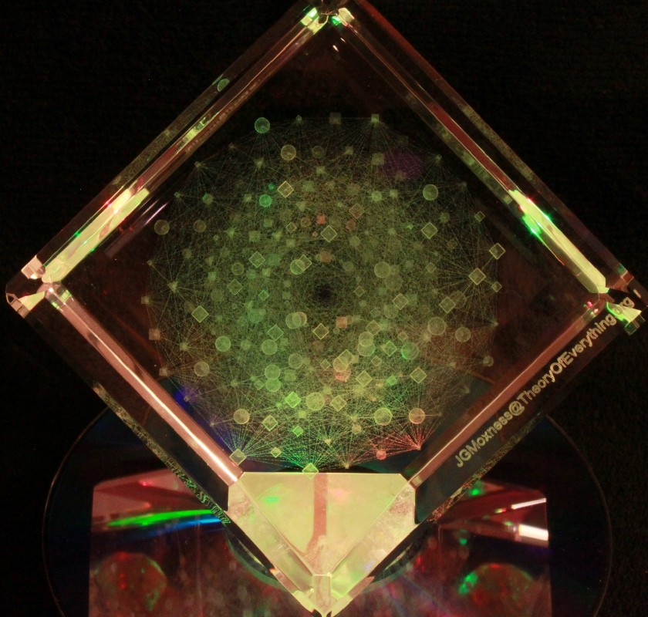
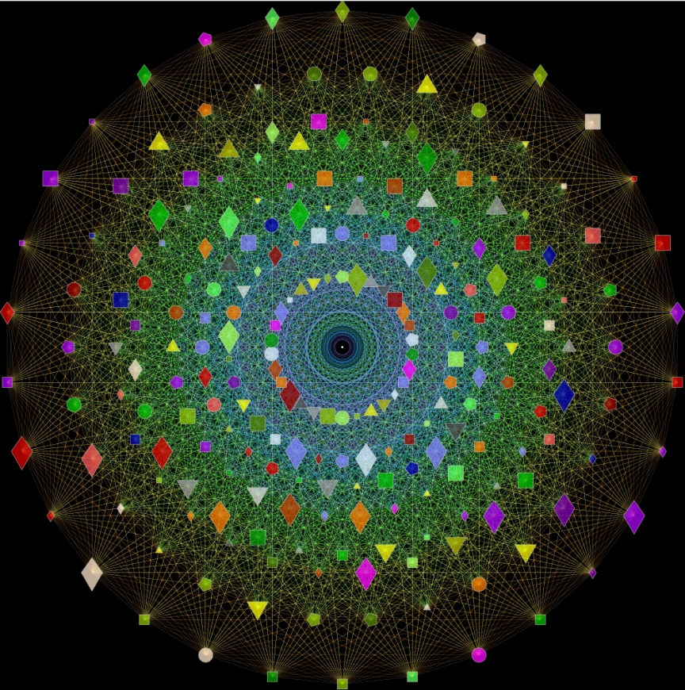
E8 with Color-Shape-Size based on Lisi Particle Assignments

Slide 36
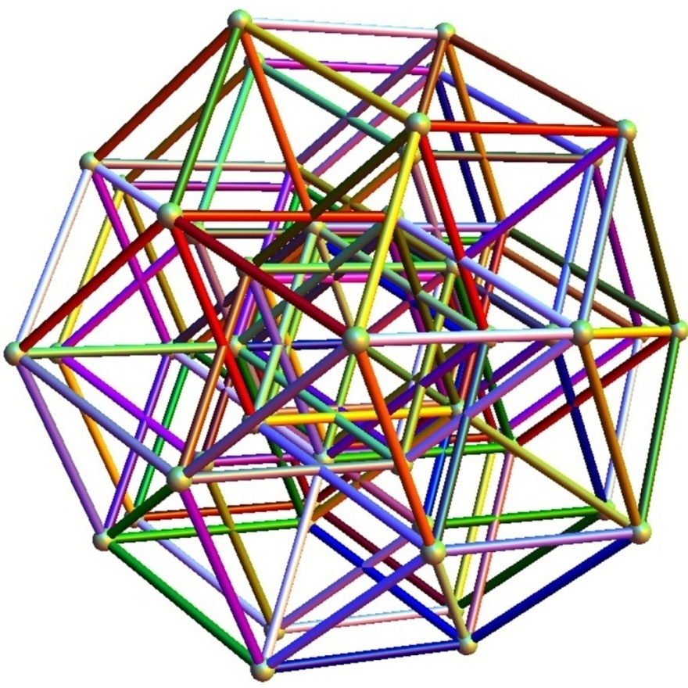
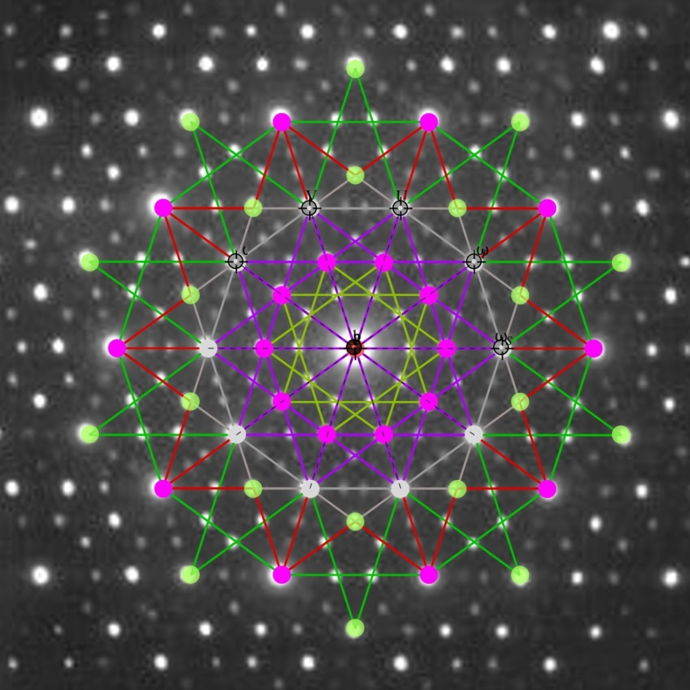
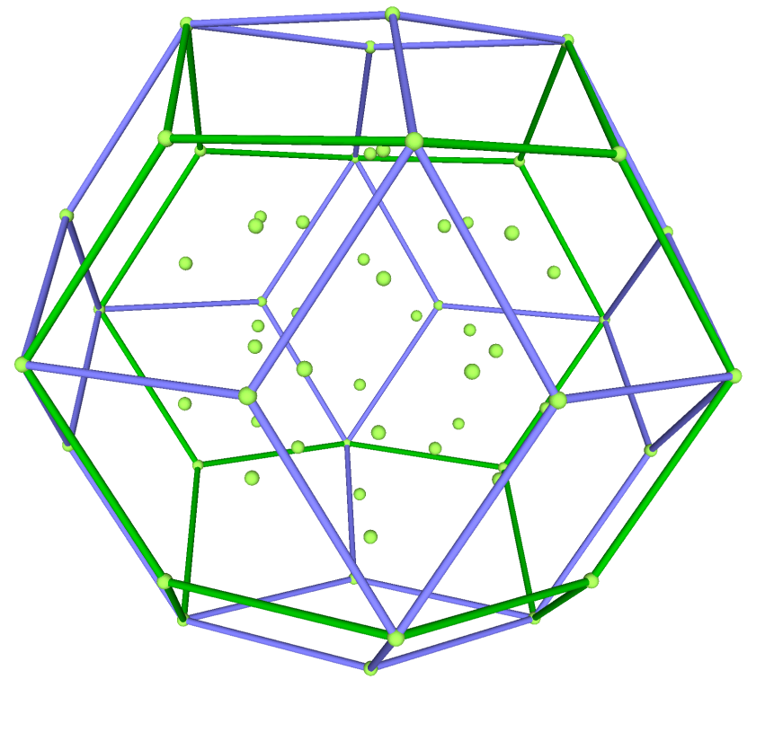
The Rhombic Tria- Contahedron, Zn-Mg-Ho QuasiCrystal Electron Diffractions

Slide 37
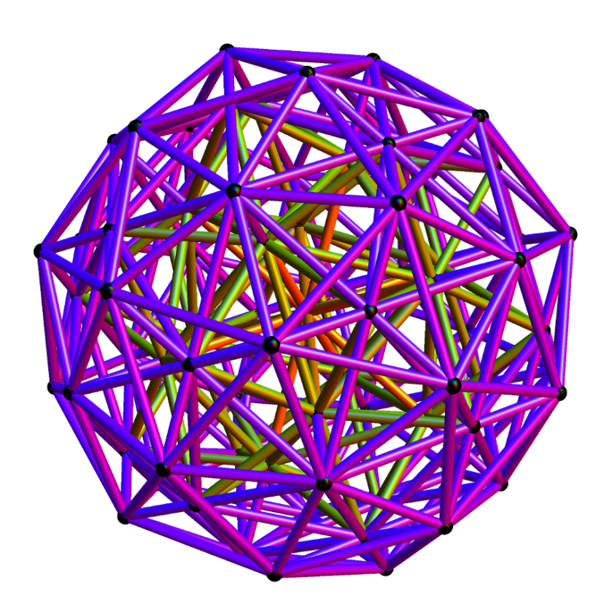
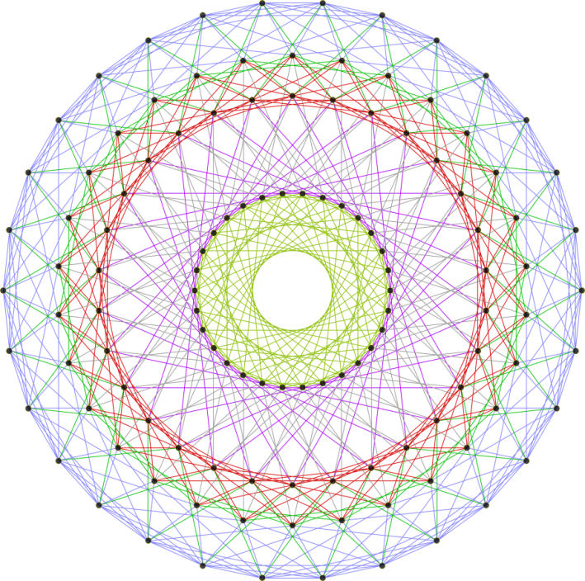
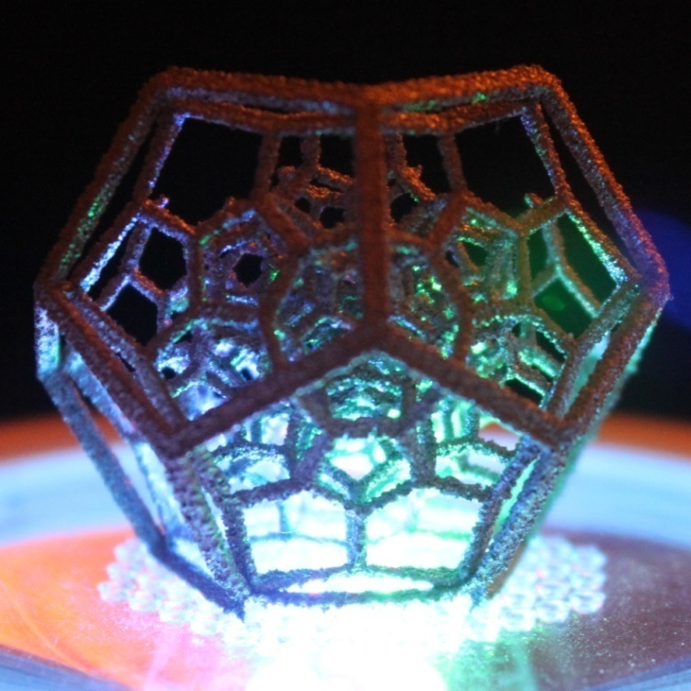
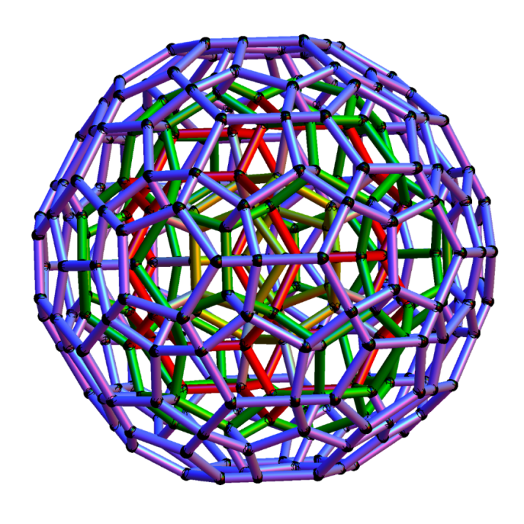
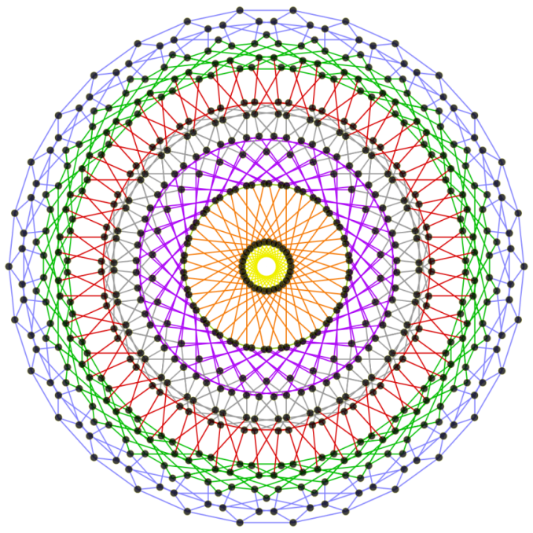
The H4 600 Cell, its dual the 120 Cell E8 folds to H4 at Golden Ratio Projection

Slide 38
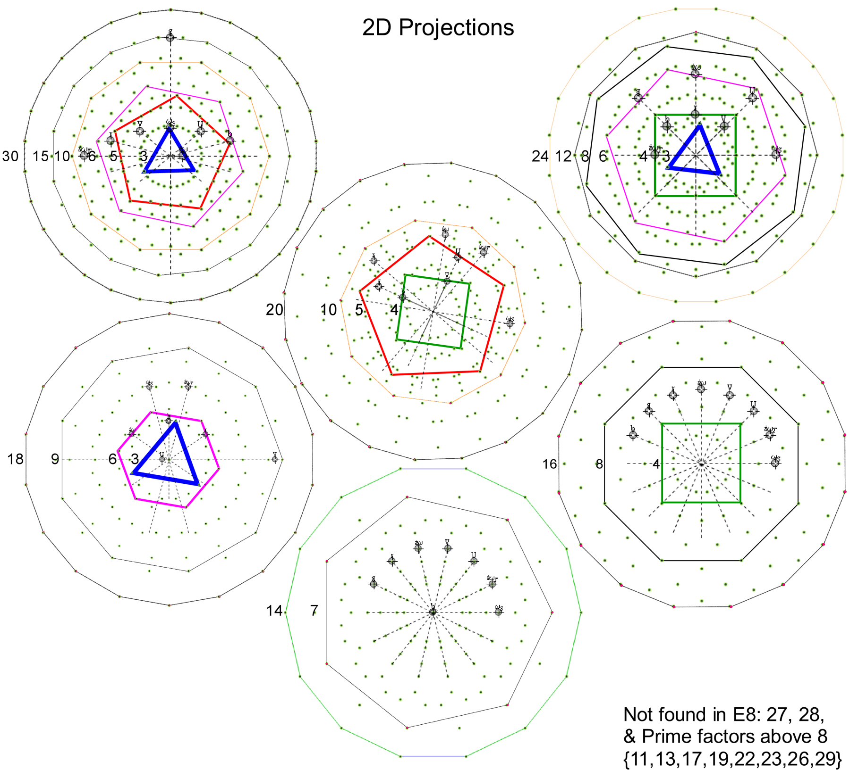
2D Projections

Slide 39
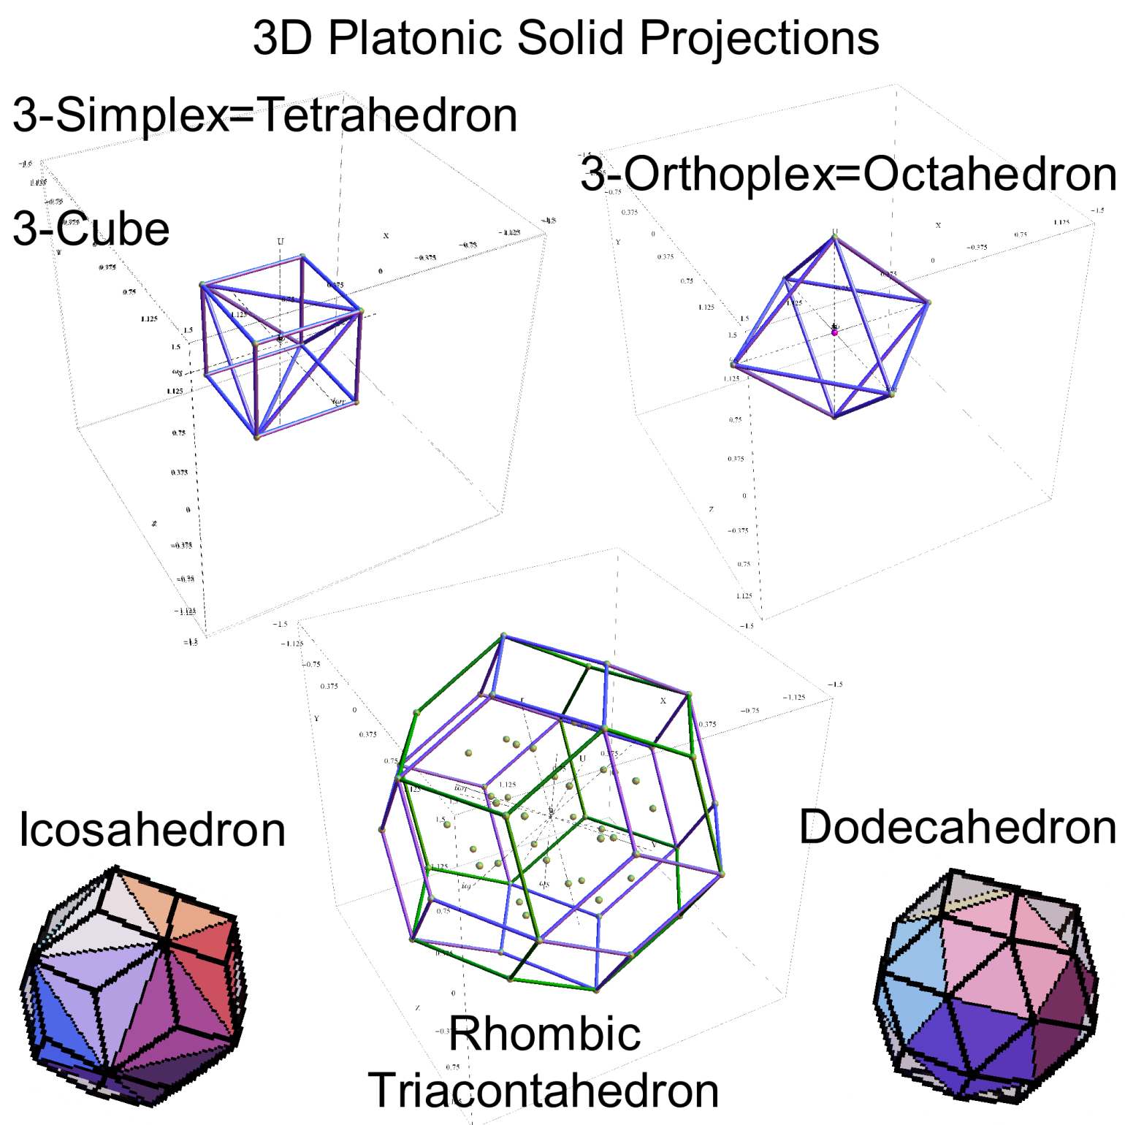
3D Projections

Slide 40
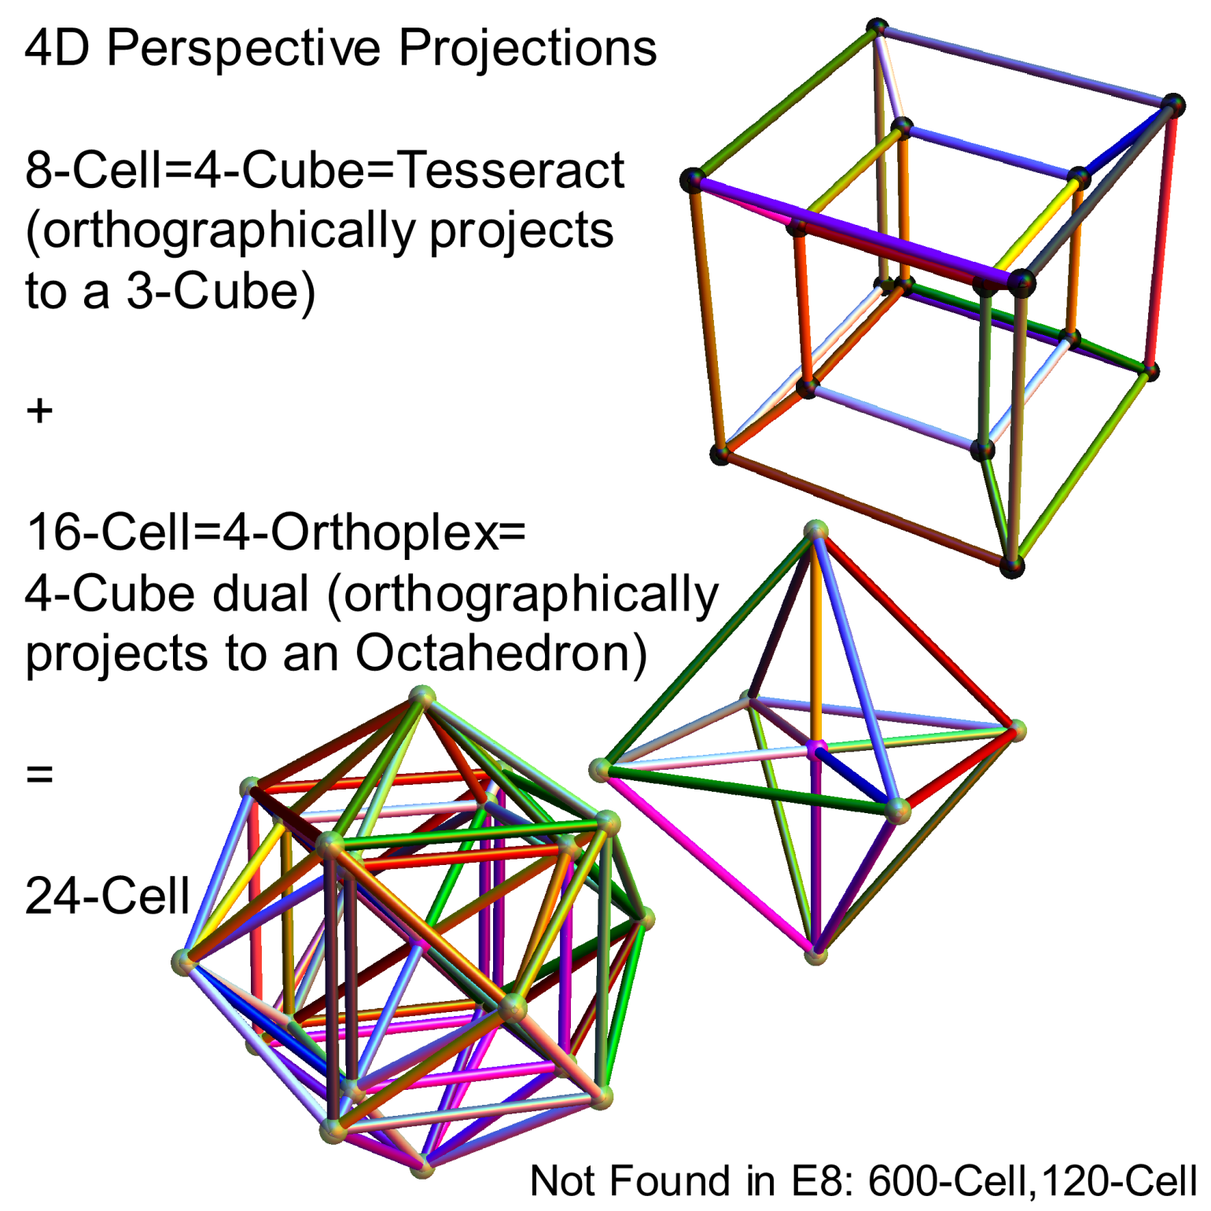
4D Projections

Slide 41
5D Projections

Slide 42
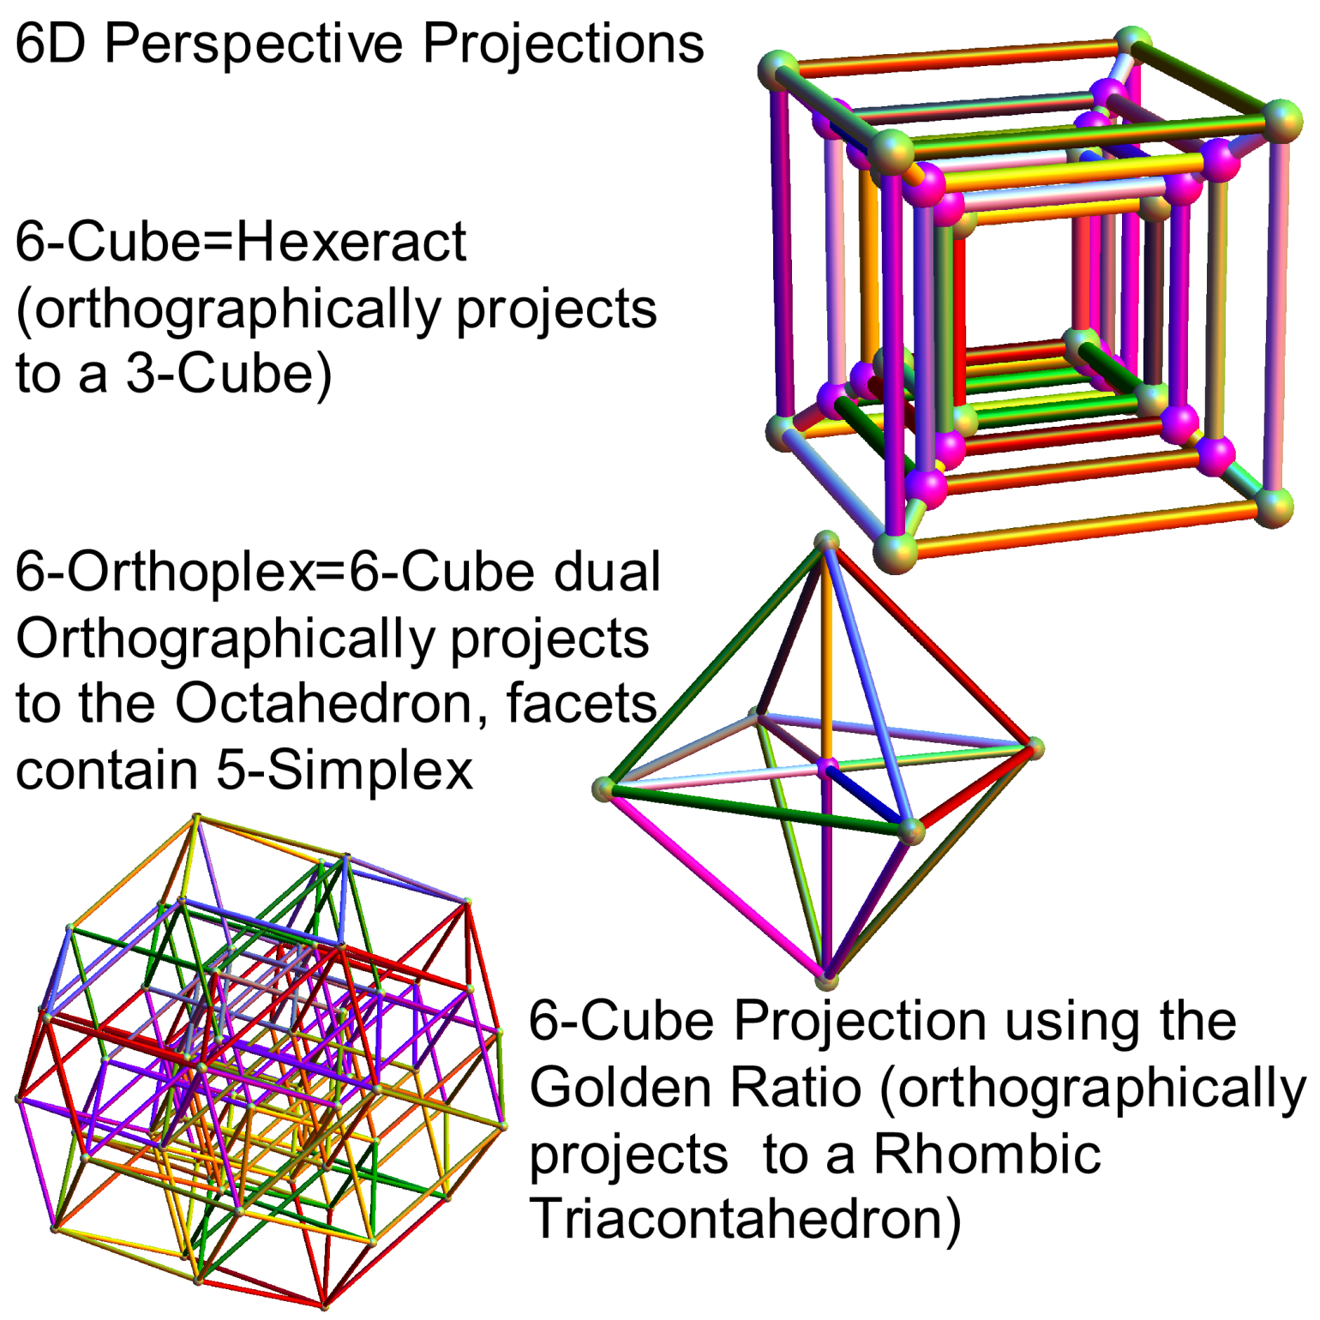
6D Projections

Slide 43
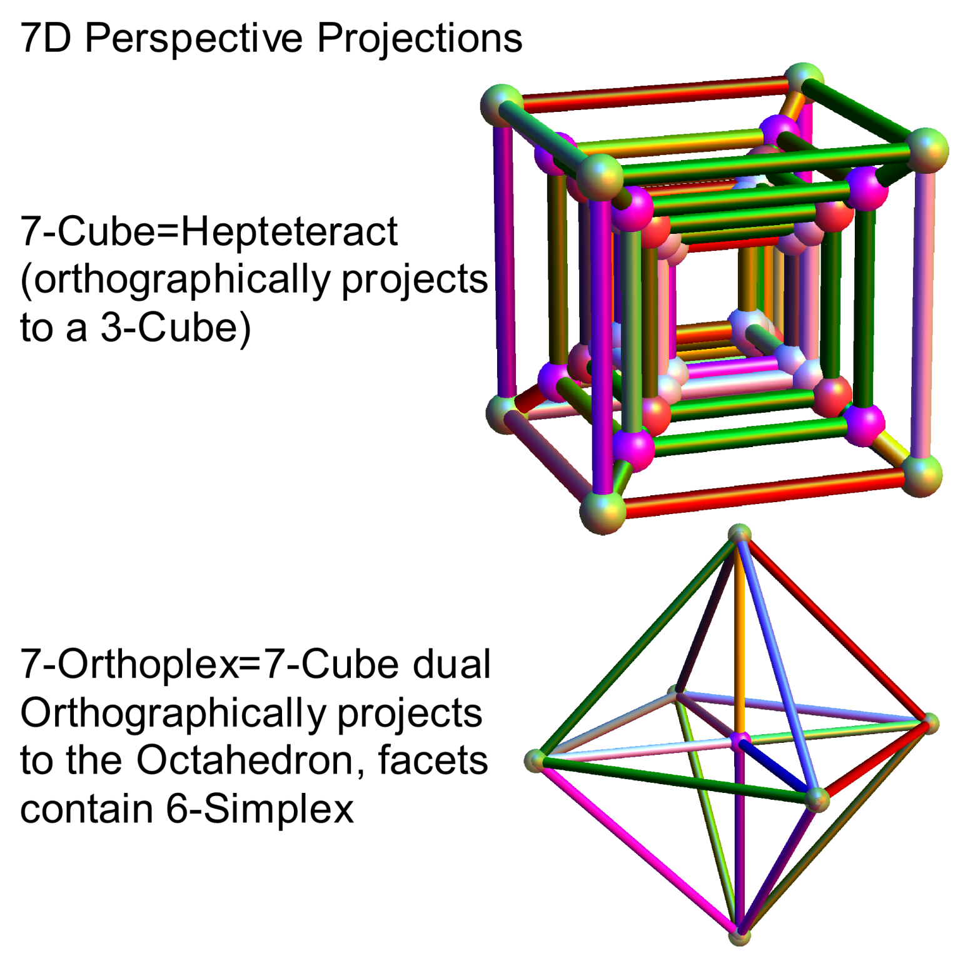
7D Projections

Slide 44
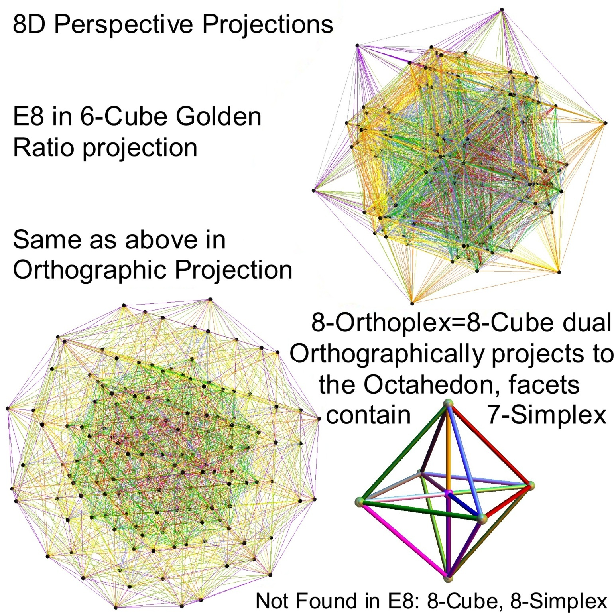
8D Projections

